Slide 1

PRESENTED BY WASIA, MUHAMMAD HARRIS & UMER AHMED
ANDROCOM
INFRASTRUCTURE-LESS
P2P COMMUNICATION
FYP PART-I : PROJECT DEFENSE
Notes:
Introduce group members, talk about title & tell what the project is.

Slide 2

INTRODUCTING ANDROCOM
AndroCom is an Android app that enables communication between Android devices without the need for an internet connection or network infrastructure by creating an ad hoc network using a microcontroller, specifically a Raspberry Pi.
Notes:
Talk about what the app is.

Slide 3
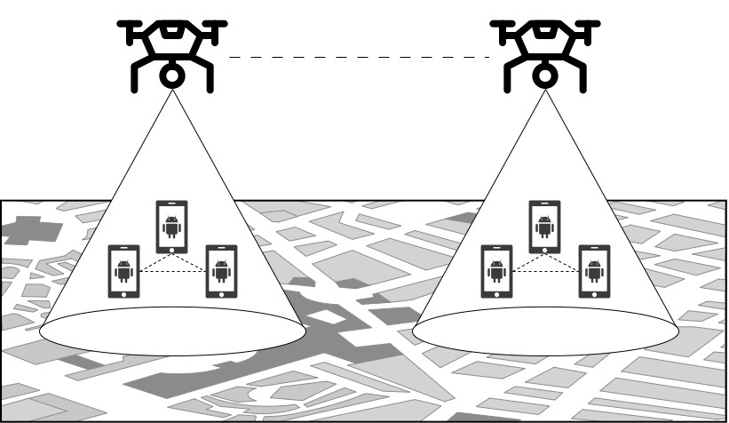
AD HOC NETWORK DEPLOYMENT

Slide 4
FUNCTIONAL REQUIREMENTS
Sr. No. | Functional Requirements | Type
1 | Configure Microcontroller for Network Connection | Core
2 | User Profile Setup in Application | Core
3 | List Active Users Connected with the Network | Core
4 | Block/Unblock Users | Intermediate
5 | Mute Messages & Chat Notifications | Intermediate
6 | Text Messages with Active Users | Core
7 | Voice Call with Active Users | Core
8 | Video Call with Active Users | Core
9 | Mute Mic or Turn-off Camera when in call | Intermediate
10 | Multicast Broadcast by Creating Groups | Intermediate
11 | Traffic Prioritization | Intermediate

Slide 5
SELECTED FUNCTIONAL REQUIREMENTS
Sr. No. | Functional Requirements | Type
1 | Configure Microcontroller for Network Connection | Core
2 | User Profile Setup in Application | Core
3 | List Active Users Connected with the Network | Core
4 | Block/Unblock Users | Intermediate
5 | Mute Messages & Chat Notifications | Intermediate
6 | Text Messages with Active Users | Core
7 | Voice Call with Active Users | Core

Slide 6
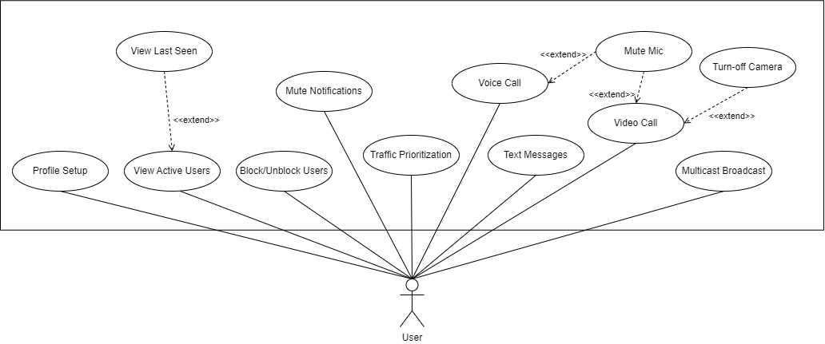
USE CASE DIAGRAM
AndroCom Application

Slide 7
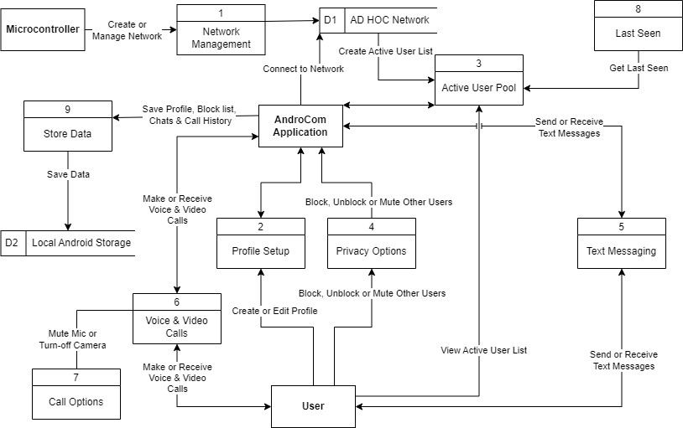
DATA FLOW DIAGRAM

Slide 8
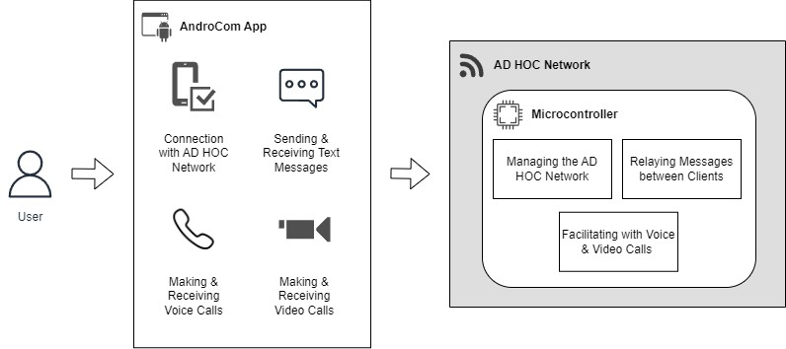
SOFTWARE ARCHITECTURE

Slide 9
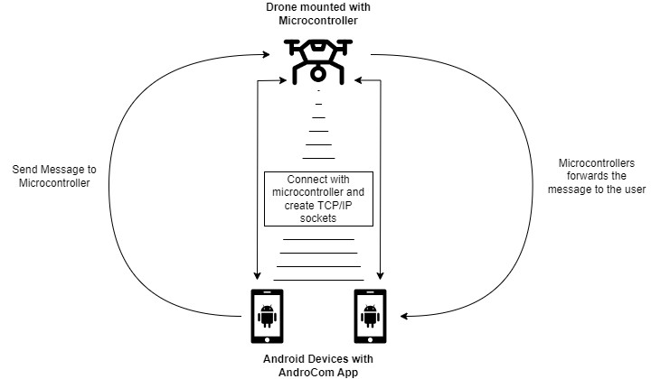
SYSTEM ARCHITECTURE

Slide 10
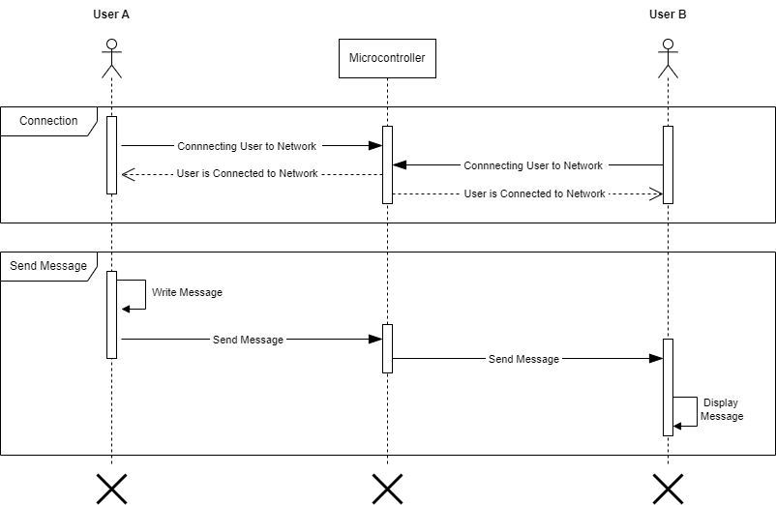
SEQUENCE DIAGRAM

Slide 11
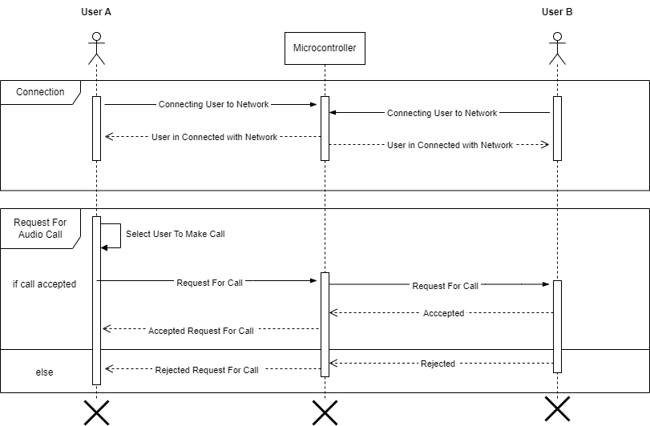
SEQUENCE DIAGRAM

Slide 12
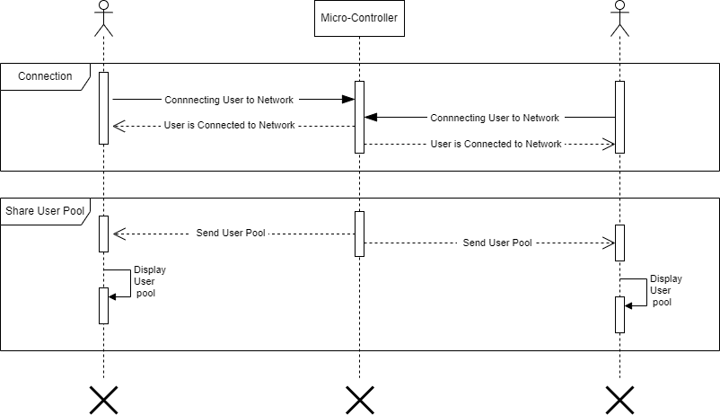
SEQUENCE DIAGRAM

Slide 13
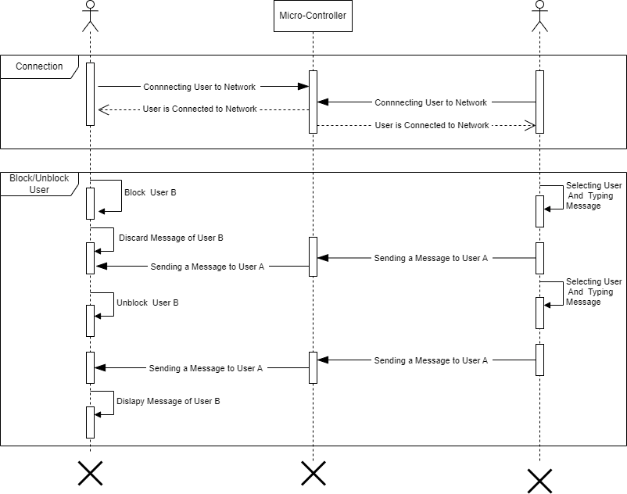
SEQUENCE DIAGRAM

Slide 14

USER INTERFACE

